Slide 1
Sending Binary Messages- Internet
Day 3

Slide 2
Lets get started!
Collect Burrill Syllabus Page 2- Next Class
Baltimore is Paying Kids- Review
Top 10 Jobs Review

Slide 3
Vocabulary
Binary - A way of representing information using only two options
Bit - A contraction of "Binary Digit"; the single unit of information in a computer, typically represented as a 0 or 1

Slide 4
Internet system
One of the least understood things about the internet is how it works as a physical system
Bits of information physically travel from one place to another. On the “real” internet bits are transmitted using a variety of different mediums
most of the time a single bit physically travels over a variety of systems to get where it’s going

Slide 5
Pairs activity
Open Code.org Unit 1- Lesson 2
Complete Group Activity- Binary Message Device- Challenge 1- Simple
Challenge 2- Complex- 4 Messages
Challenge 3- 8 Possible Messages
Challenge 4- 16 Possible Messages
Complete Rest of Unit 1- Lesson 2

Slide 6
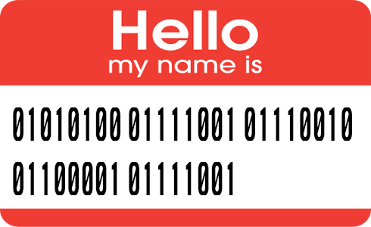
Code.org- Unit 1- Lesson 3- Sending Binary Messages with the internet simulator
Today, the Internet Simulator at code.org will be used to simulate a single shared wire, connecting two people.
A goal of using the internet simulator was put best by a student near the conclusion of Unit 1 who said "Whoa, I feel like I just invented the Internet!"

Slide 7
Vocab- Journal Entries
Vocabulary
Bit Rate, Bandwith, Protocal, Latency, Byte, Kilobyte, Megabyte, Ethernet Wire, Fiber Optic Cable, Wireless (WiFi)
Watch Video
Complete Unit 1- Lesson 3- You have already watched the video

Slide 8
Questions
All Good?
Questions?
Concerns?
Pace?

